Slide 1
Consensus
Bernard Parenteau
bparente@fit.edu

Slide 2
Consensus
If a system is decentralized and there are no nodes in charge, then the system needs some defined way to come to agreement as to what are valid transactions, how and in what order are they entered into transaction history.
This is crucial in any case, and even more so when history is immutable and there are no provisions for rollback or adjustments.
The method that nodes use to come to agreement is called consensus.
There are many consensus algorithms and methodologies; it’s an active area of research.
And it is an area in which different blockchains and cryptocurrencies differentiate themselves.

Slide 3
Consensus
Bitcoin uses Proof of Work and the convention that the longest valid blockchain represents the actual state.
Bitcoin pioneered the use of PoW for blockchains.
As we’ve seen, PoW typically involves substantial energy consumption and frequently an arms race among miners, lending itself somewhat to mining centralization.
Nevertheless, many blockchains use variations of Bitcoin’s PoW, and many use alternate consensus systems.

Slide 4
Bitcoin-like Mining
There are also several other coins mined exactly like Bitcoin with SHA256
Bitcoin Cash (BCH)
NMC Namecoin; .bit top level domain
Peercoin (from 2012; first combined PoW/PoS “minting”)
A number of thinly traded, relatively obscure coins

Slide 5
Useful Mining
There are other coins with unusual mining schemes that seek to have the Work in PoW be useful work:
Primecoin (from 2013; finding chain of primes, useful in Math)
Gridcoin (Proof of Research on BOINC projects https://boinc.berkeley.edu/); like many coins, it had some popularity for a while but is extremely thinly traded now
SolarCoin (coin reward for producing solar energy); like above, had some popularity but little activity lately

Slide 6
Ethereum: Ethash
Ethereum is the second largest crypto blockchain after Bitcoin by several measures, including capitalization
Ethash is the PoW algorithm for Ethereum 1.0.
It is a substantially modified version of Dagger-Hashimoto, derived from two separate algorithms, in which many of the original features of both algorithms have been drastically changed
The seed for each block can be computed by scanning through the block headers up until that point.
A 16 MB pseudorandom cache can be calculated from the seed.
A 1 GB dataset is generated from the cache, with the property that each item in the dataset depends on only a small number of items from the cache.
This dataset is called a DAG (Directed Acyclic Graph), and is regenerated every 30,000 blocks (or every ~5 days)
https://eth.wiki/en/concepts/ethash/ethash

Slide 7
Ethash
Ethhash mining involves reading pieces of the dataset and hashing them together, so the vast majority of a miner's effort will be reading the dataset.
The design was meant to be ASIC-resistant or at least ASIC-hard, as we’ll discuss in more detail next
But in Spring 2018, Bitmain announced an Antminer ASIC machine specifically for Ethereum mining
While mining is memory-intensive, verification can be done with low memory by using the cache to regenerate the specific pieces of the dataset that you need, so light clients can verify.
In Ethereum, light clients can store only the cache, while full clients and miners store the dataset.

Slide 8
Dagger Hashimoto
Dagger Hashimoto itself was designed to satisfy exactly those two goals:
ASIC-resistance: the benefit from creating specialized hardware for the algorithm should be as small as possible, ideally to the point that even in an economy where ASICs have been developed the speedup is sufficiently small that it is still marginally profitable for users on ordinary computers to mine with spare CPU power.
Light client verifiability: a block should be relatively efficiently verifiable by a light client.
https://github.com/ethereum/wiki/wiki/Dagger-Hashimoto

Slide 9
Ethash - Hashimoto
Dagger Hashimoto, upon which Ethhash was derived, is itself derived from two algorithms
Hashimoto, an algorithm by Thaddeus Dryja which intends to achieve ASIC resistance by being IO-bound, i.e. making memory reads the limiting factor in the mining process.
The theory is that RAM is a much more generic ingredient than computation, and billions of dollars of research already go into optimizing it for different use cases which often involve near-random access patterns (hence "random access memory"); so existing RAM is likely to be moderately close to optimal for evaluating the algorithm.
https://github.com/ethereum/wiki/wiki/Dagger-Hashimoto

Slide 10
Ethash - Dagger
Dagger, is an algorithm by Vitalik Buterin, the creator of Ethereum, which uses directed acyclic graphs to simultaneously achieve memory-hard computation but memory-easy validation.
A Directed Acyclic Graph (DAG) is like a flowchart where nodes can have multiple upstream inputs and lead to multiple downstream nodes
In Dagger the DAG has 9 levels with multiple nodes on each, which each depend on multiple nodes in the previous level, and calculation is intensive, and the DAG itself is large (compared to memory sizes)
When hashing, each nonce is combined with several node values, the selection and calculation of which depends on the nonce itself.
The idea is that each nonce only requires a small portion of a large total data tree, and recomputing the subtree for each nonce is prohibitive for mining, but okay for a single nonce's worth of verification. So miners must store entire tree and read it for each nonce, becoming essentially I/O bound.
https://github.com/ethereum/wiki/wiki/Dagger-Hashimoto

Slide 11
Ethash - Dagger
Dagger was meant to be an alternative to existing memory-hard algorithms like Scrypt, which are memory-hard but are also very hard to verify when their memory-hardness is increased to genuinely secure levels.
However, Dagger was proven to be vulnerable to shared memory hardware acceleration (ASIC optimizable) by Sergio Lerner and was then dropped in favor of other avenues of research.
https://bitslog.wordpress.com/2014/01/17/ethereum-dagger-pow-is-flawed/

Slide 12
Ethash Hardware
Ethereum Classis (ETC) is the only other cryptocurrency with substantial volume that uses Ethash
Apart from the somewhat recent Antminers from Bitmain, Ether mining is (was) usually done with the following:
GPUs
Graphics Processing Units; ideal for parallel processing used in mining. Some may be overclocked.
Multiple GPUs are connected to a motherboard with a processor
Nvidia and AMD are the main GPU manufacturers
https://www.techspot.com/news/73482-cryptocurrency-miners-help-amd-close-gap-nvidia-gpu.html
FPGAs
Field Programmable Gate Arrays; programmable chips
Quicker to develop than ASICs, so quicker to new mining algorithms
Relatively expensive cost to buy, low-cost to operate

Slide 13
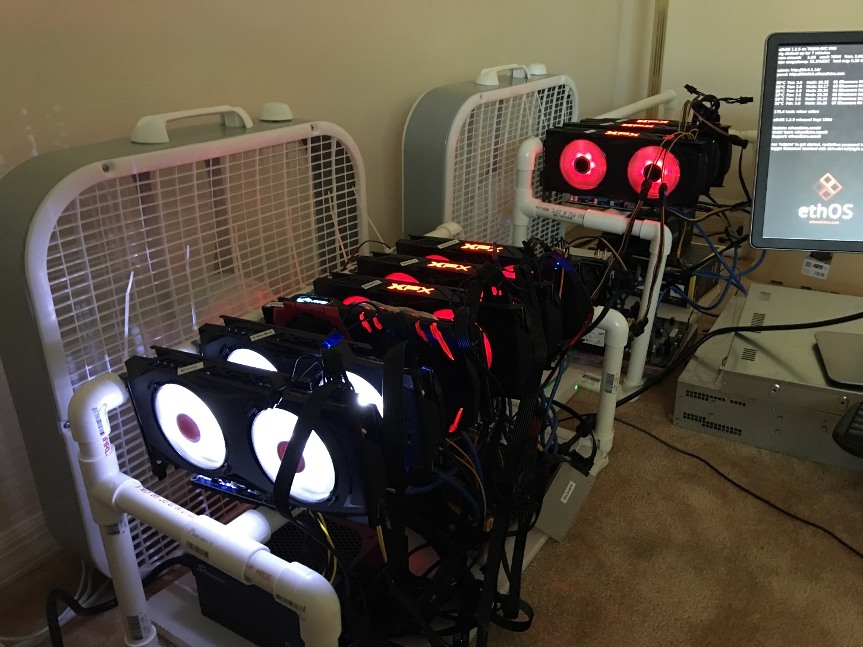
GPU Minig Rig

Slide 14
Scrypt
A number of cryptocurrencies make use of Scrypt-based mining algorithms, including LTC, Verge, Doge, Monacoin, ViaCoin …
Scrypt is a password-based key derivation function created by Colin Percival, originally for the Tarsnap online backup service.
The algorithm was designed to make it costly to perform large-scale custom hardware attacks (e.g. rainbow tables) by requiring large amounts of memory.
It was first used by LTC, an early fork of Bitcoin.
It is more memory-intensive than SHA and was though to be relatively ASIC-resistant, though within a few years ASICs were developed
In 2016, the Scrypt algorithm was published by IETF as RFC 7914.
https://themerkle.com/scrypt-vs-x11-vs-sha-256/, https://en.wikipedia.org/wiki/Scrypt
http://www.tarsnap.com/scrypt/scrypt.pdf

Slide 15
Scrypt
There are actually several Scrypt-based mining algorithms, including Scrypt-N, Scrypt-Jane, Scrypt-OG.
Scrypt-N changes the memory requirement of the algorithm at regular intervals so that even if ASICs are developed for the algorithm, a few years later they become obsolete.
Scrypt-OG is 8 times less memory-intensive than Scrypt. In fact, the term “OG” stand for “Optimized for GPU”.
https://themerkle.com/scrypt-vs-x11-vs-sha-256/, https://en.wikipedia.org/wiki/Scrypt
http://www.tarsnap.com/scrypt/scrypt.pdf

Slide 16
X11
X11 was created by Dash core developer Evan Duffield and began to be used in mining in 2014.
DASH is the main cryptocurrency using X11, though PIVX and several other mostly thinly traded coins are forks of Dash and also use it. (more on Dash later)
It uses 11 different rounds of hashes (as in the name X11), and became popular to due relative energy-efficiency (and therefore cost-efficiency for both processing and cooling) while mining with a GPU or CPU.
X11 was designed to be ASIC-hard, and at least temporarily ASIC-resistant, which allowed general purpose CPUs and GPUs to mine.
https://themerkle.com/scrypt-vs-x11-vs-sha-256/
https://docs.dash.org/en/stable/introduction/features.html

Slide 17
X11
Once Dash became popular and more valuable, ASIC designers began working on implementing X11.
But the ASIC difficulty slowed their introduction and allowed substantial distributed mining operations to be in place before ASIC machines began aiding centralization.
The X11 algorithm remains a secure solution for cryptocurrency developers looking to hinder brute-force attacks.
The next iterations of this algorithm are X13, X14, X15, and X17. As the names imply, X13 contains 13 rounds of hashes, X15 contains 15, … .
https://themerkle.com/scrypt-vs-x11-vs-sha-256/
https://docs.dash.org/en/stable/introduction/features.html

Slide 18
CryptoNight
CryptoNight is a memory-bound hash algorithm which is typically used with the Cryptonote protocol
It is used by Monero, ByteCoin, DigitalNote, Aeon, …
It relies on random access to memory.
As opposed to Scrypt, every new block (64 bytes in length) depends on all the previous blocks, so a hypothetical "memory-saver" should increase calculation speed exponentially making it effectively memory-intensive.
https://en.bitcoin.it/wiki/CryptoNote
https://monerodocs.org/proof-of-work/cryptonight/
https://en.bitcoinwiki.org/wiki/CryptoNight

Slide 19
CryptoNight
Its requirement for about 2 Mb per instance was designed for the following reasons:
1. It fits in the L3 cache (per core) of modern processors,
2. A megabyte of internal memory is an almost unacceptable size for a modern ASIC pipeline
3. GPUs may run hundreds of concurrent instances, but they are limited in other ways: GDDR5 memory is slower than the CPU L3 cache and remarkable for its bandwidth, not random access speed.
The bottom line is that it is designed to make CPU and GPU mining roughly equally efficient (maybe CPUs even more efficient) and restrict ASIC mining.
https://en.bitcoin.it/wiki/CryptoNote
https://monerodocs.org/proof-of-work/cryptonight/
https://en.bitcoinwiki.org/wiki/CryptoNight

Slide 20
EquiHash
EquiHash is used by ZCash, ZClassic, Bitcoin Gold
It was developed, and presented in 2016, by researchers at CryptoLUX, University of Luxembourg.
It is a memory-oriented PoW suitable for general purpose CPUs but purposely ASIC-resistant, to reduce chance of a concentration in mining due to specialized hardware
It also allows for efficient verification to enable light clients, such as those on mobile devices, to do verification
It was implemented by ZCash in 2016
http://orbilu.uni.lu/handle/10993/22277, https://www.cryptolux.org/index.php/Equihash
https://bitcoinmagazine.com/articles/how-equihash-algorithm-could-democratize-zcash-mining/

Slide 21
Proof of Work Alternatives
Not all blockchains and coins have PoW mining.
Many use alternative consensus algorithms, and as we’ll see, many alternatives have been devised.

Slide 22
Byzantine Fault Tolerance
Byzantine Fault Tolerance is a method to reach consensus about whether nodes in a network or distributed system are problematic (should be considered out of service) when nodes can give inconsistent signals to various other nodes
It was originally applied to distributed systems and was based on the general idea of the Byzantine generals problem: How to reach consensus if some of the network participants are unreliable or dishonest
Bitcoin’s consensus algorithm using Proof of Work and accepting the longest chain, is one way to reach consensus even if various and unknown nodes may be malicious, and the algorithm will work as long as at least 51% of nodes are honest.
http://pmg.csail.mit.edu/papers/osdi99.pdf

Slide 23
Practical Byzantine Fault Tolerance
There are various Byzantine Fault Tolerance algorithms
Practical Byzantine Fault Tolerance (pBFT) uses a lead node for each request, and that lead node is itself varied from request to request.
The selected lead node then receives a request from another node and broadcasts it to all nodes.
The nodes process the request and send the response to the original requestor, who waits up to a max amount of time for matching responses from a sufficient number of other nodes.
The advantages include relatively instant transaction finality rather than waiting for “confirmations” (additional blocks) as Bitcoin does.
A disadvantage is the amount of communication required in networks with a large number of nodes, or conversely, the possibility of a malicious node impersonating many nodes (“sybil attack”) in a smaller network.

Slide 24
PBFT Implementations: ZIL
Zilliqa (ZIL) uses an optimized version of PBFT for consensus with PoW used for identity and to verify the blockchain every several 100 blocks
Zilliqa is a smart contract environment, using its own functional language Scilla
The network uses sharding (parallel subnets) and is designed to scale to 1000s of transactions per second
It stems from a number of academic papers, including ones on sharding, consensus and formal verification
It has been in development since 2016 and the mainnet launch, originally scheduled for 2018 Q3, occurred at the end of January 2019.
In October 2020 it said staking would soon be introduced on mainnet
https://www.zilliqa.com/
https://blog.zilliqa.com/the-zilliqa-design-story-piece-by-piece-part-2-consensus-protocol-e38f6bf566e3

Slide 25
Federated Byzantine Agreement
FBA consensus was first implemented by Ripple (XRP) in their network, and later refined by Stellar (XLM) as Stellar Consensus Protocol or “SCP” and used in their network
Nodes use their own criteria in determining which nodes to rely upon for consensus
This clearly lends itself to a network in which not all nodes are anonymous

Slide 26
dBFT and Consensus nodes: NEO
NEO; delegated Byzantine Fault Tolerance
Created by Da Hongfei, originally called AntShares
First Chinese open source blockchain, sometimes referred to as Chinese Ethereum due to similarities
Combines Smart Contracts and Digital Assets for what it calls Smart Assets
NEO in NEO wallets earn GAS cryptocurrency which can pay for processing on NEO network (some exchanges credit you with your GAS, others don’t)
There are consensus nodes that must meet certain requirements and are then voted in by the other nodes.
Consensus nodes may vote, enforce governance, and may charge transaction fees, which are currently minimal.
https://neo-ngd.github.io/reference/How-To-Become-NEO-Consensus-Node.html
https://docs.neo.org/tutorial/en-us/3-transactions/4-NEO_transaction_fees.html

Slide 27
Proof of Stake
Proof of Stake is a concept that nodes will stake a balance of coins to vouch for the veracity of a new block. In other words they guarantee correctness and back it with their stake.
This avoids the power consumption of PoW.
Nodes are then rewarded for these stakes, though typically less than a PoW miner as less is required.
PoS is sometimes used for pre-mined blockchains and others that also don’t have block rewards.
Stakeholders with larger balances are typically selected more often and therefore more highly rewarded.

Slide 28
Proof of Stake
PoS is relatively safe as an attacker who wanted to make a fraudulent transaction would need a substantial amount of coins to process those required transactions reliably;
acquiring those coins would likely push the price up and if fraud was detected the price would likely plummet, making such an attack counter-productive.
There is no single way to implement Proof of Stake, but rather any number of ways
Nxt was one of the earliest users of PoS, introducing its use in 2013
Ethereum has implemented PoS in its Eth 2.0 chain, which is live with its beacon chain as of late 2020, and is planned to merge with Eth in 2022
https://ethereum.org/en/eth2/

Slide 29
Proof of Stake Variations
Leased Proof of Stake (LPoS)
In classic PoS, holders with small balances are unlikely to stake a block — just as small miners with low hashrate are unlikely to mine a block in bitcoin. It may be many years before a small holder is lucky enough to generate a block. This means that many holders with low balances don’t run a node, and leave maintaining the network to a limited number of larger players. Since network security is better when there are more participants, it is important to incentivise these smaller holders to take part.
LPoS achieves this by allowing holders to lease their balances to staking nodes. The leased funds remain in the full control of the holder, and can be moved or spent at any time (at which point the lease ends). Leased coins increase the ‘weight’ of the staking node, increasing its chances of being allowed to add a block of transactions to the blockchain. Any rewards received are shared proportionally with the leasers. This is the approach taken by Waves.
https://docs.waves.tech/en/blockchain/leasing

Slide 30
Proof of Stake Variations
Proof of Importance (PoI)
Another variation on these consensus mechanisms is PoI.
The first cryptocurrency platform to implement this was NEM.
With PoI, it is not simply coin balance that matters.
NEM’s consensus system is based on the idea that productive network activity, not just the amount of coins, should be rewarded.
The odds of staking a block are a function of a number of factors, including balance, reputation (determined by a separate purpose-designed system), and the number of transactions made to and from that address.
This provides a more holistic picture of a ‘useful’ network member.

Slide 31
Delegated Proof of Stake
DPoS was first described by Dan Larimer in the early days of Bitcoin as a potential consensus mechanism for Bitcoin
It is used by Bitshares (BTS) which was started by Larimer in 2013 and went live in its current form in 2015.
Larimer was later involved with the inception of Steemit and EOS.
With DPoS, coin holders use their balances to elect a list of nodes that will have the opportunity to stake blocks of new transactions and add them to the blockchain.
This is meant to engage all coin holders
Holders can also vote on changes to network parameters, giving them greater influence and ownership over the network.

Slide 32
Hybrids
Dash: PoW/PoS hybrid
Originally called DarkCoin, uses Bitcoin core with additional privacy features such as built-in “mixing” capabilities
Uses X11 for PoW mining
Uses Masternodes for additional privacy features and governance
Masternodes are a variation of PoS; 1000 DASH are required, but it’s not “staked” in the sense that it’s not at risk.
PIVX
Forked from DASH, also hybrid

Slide 33
Permissioned Blockchains Consensus
Permissioned blockchains typically do not need the same types of consensus algorithms as permissionless, anonymous, open blockchain neworks.
If nodes are known and/or if there are administrators, consensus can more easily be defined.
Nevertheless there can still be substantial variations
As an example, Hyperledger has sever varieties of consensus algorithms, as depicted on the following diagram.

Slide 34
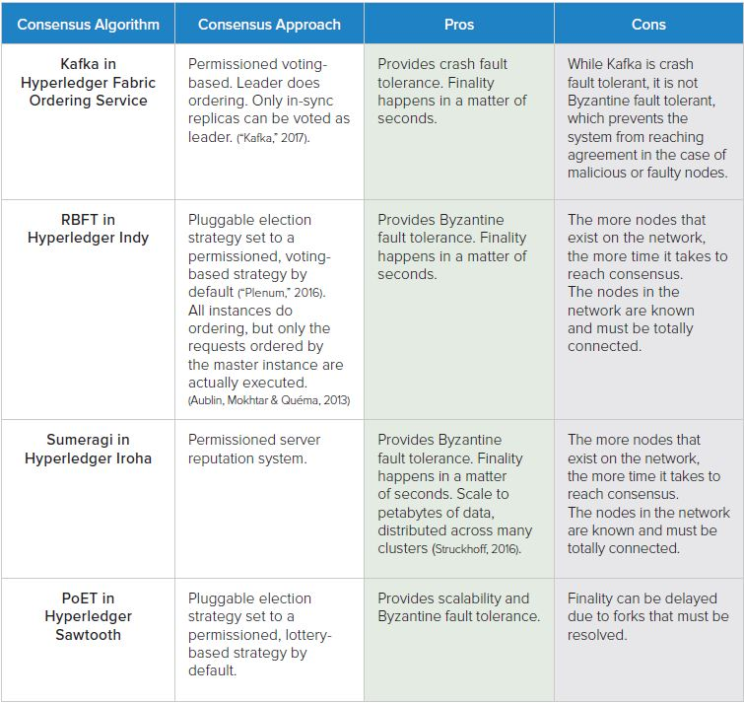
https://www.hyperledger.org/wp-content/uploads/2017/08/Hyperledger_Arch_WG_Paper_1_Consensus.pdf

Slide 35
Blockchain Consensus
With permissioned blockchains, other schemes such as Proof of Authority may be used, or polling a set of predetermined nodes may also be used.
Since there is some degree of trust (though not necessarily full-trust) in permissioned blockchains, the consensus problem can more easily be addressed.
With permissionless, anonymous, immutable blockchains such as Bitcoin and most cryptocurrencies, secure consensus is a difficult issue.
Consensus remains an active area of development and interest, and one in which many cryptocurrencies seek to distinguish themselves.

